Slide 1




AHMEDABAD BRTS ROUTE APP

Slide 2




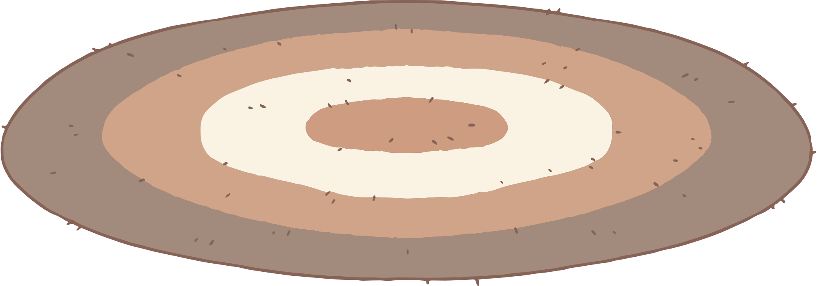
OUR TEAM
1) Mihir Patel
2) Navin Sengundhar
3) Abhishek Kachhadiya
4) Fulesh Desai
5) Pratham Kavar

Slide 3
PROJECT INTRODUCTION
Introduce the Bus Rapid Transit System (BRTS) application designed to manage routes efficiently.

Slide 4
IT CONSISTS OF 3 PARTS
01 - LOGIN PAGE
02 - HOME PAGE
03 - BACKEND

Slide 5
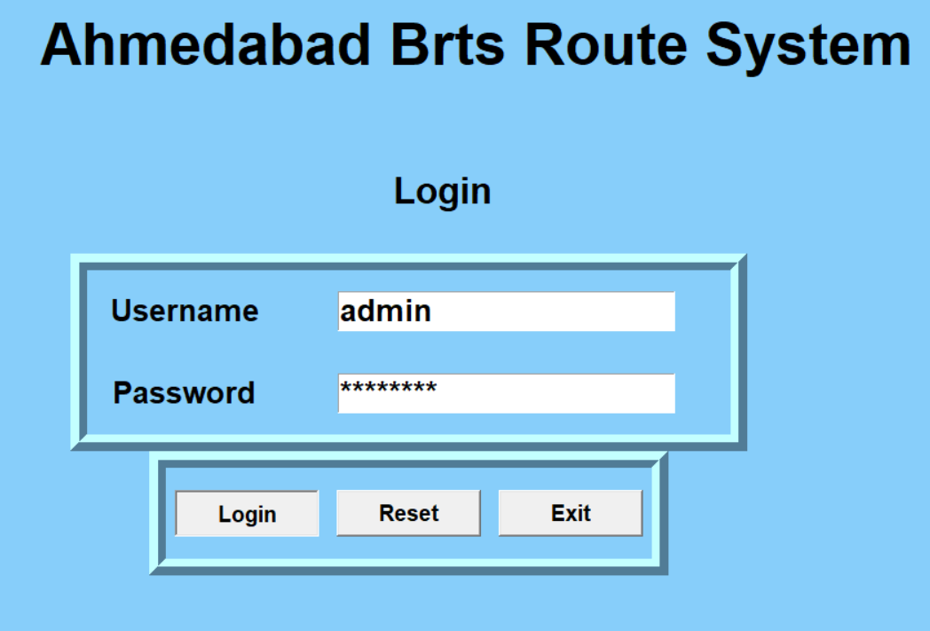
LOGIN PAGE
The login window in login.py provides a simple and secure interface for users to authenticate themselves before accessing the main functionalities of the application. It ensures user privacy and security by validating login credentials and allowing users to reset or exit if needed.

Slide 6
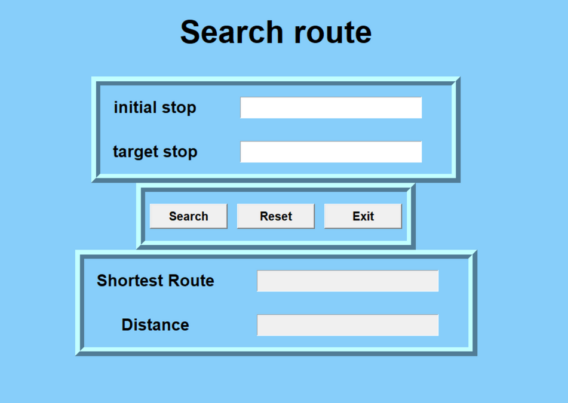
HOME PAGE
The user interaction implemented in user.py provides a user-friendly interface for searching routes in the BRTS application. Users can input bus stops, initiate route searches, receive route information, and interact with the application effectively through the provided buttons and functionalities.

Slide 7
BACKEND
The backend logic in app.py establishes the foundation for managing the BRTS route, including defining the route graph, adding stations and distances, and calculating the shortest route between stops using Dijkstra's algorithm. This logic forms the core functionality of the BRTS application, enabling efficient route management and navigation.

Slide 8
DJIKSTRA ALGORITHM
Dijkstra's algorithm finds the shortest path in a weighted graph from a source node to all other nodes. It initializes distances, relaxes edges, and updates paths iteratively. The shortest path is reconstructed by backtracking from the target node using parent pointers. It's efficient with time complexity O(E log V).

Slide 9
SCALABILITY AND FUTURE ENHANCEMENTS
1
Real-time Updates
2
User Profiles
3
Mobile Application
4
Accessibility Features

Slide 10
THANK YOU

